Slide 1
Introduction to the Arduino
Ryan Brock

Slide 2
About Me
Ryan Brock
Software Engineer – 14 Years
Purdue University – Computer Science
Motorola
Zebra Technologies

Slide 3
Contact
Twitter: @borq79
Email: borq79@gmail.com
Github Repo:
https://github.com/borq79/Cary-Area-Public-Library-Classes

Slide 4
Agenda
Intro (5 Minutes)
Quick Basics (10 Minutes)
Project 1 (15 Minutes)
Bring and LED to life
So What Just Happened? (15 Minutes)
Basic Circuit
What is an LED
Voltage / Current / Resistance
Project 2 (20 Minutes)
Introducing a button into the circuit
Project 3 (20 Minutes)
Reading the Temperature of the Room
Project 4 (25 Minutes)
Multicolor LEDs

Slide 5
Breadboard
Where is C:19?

Slide 6
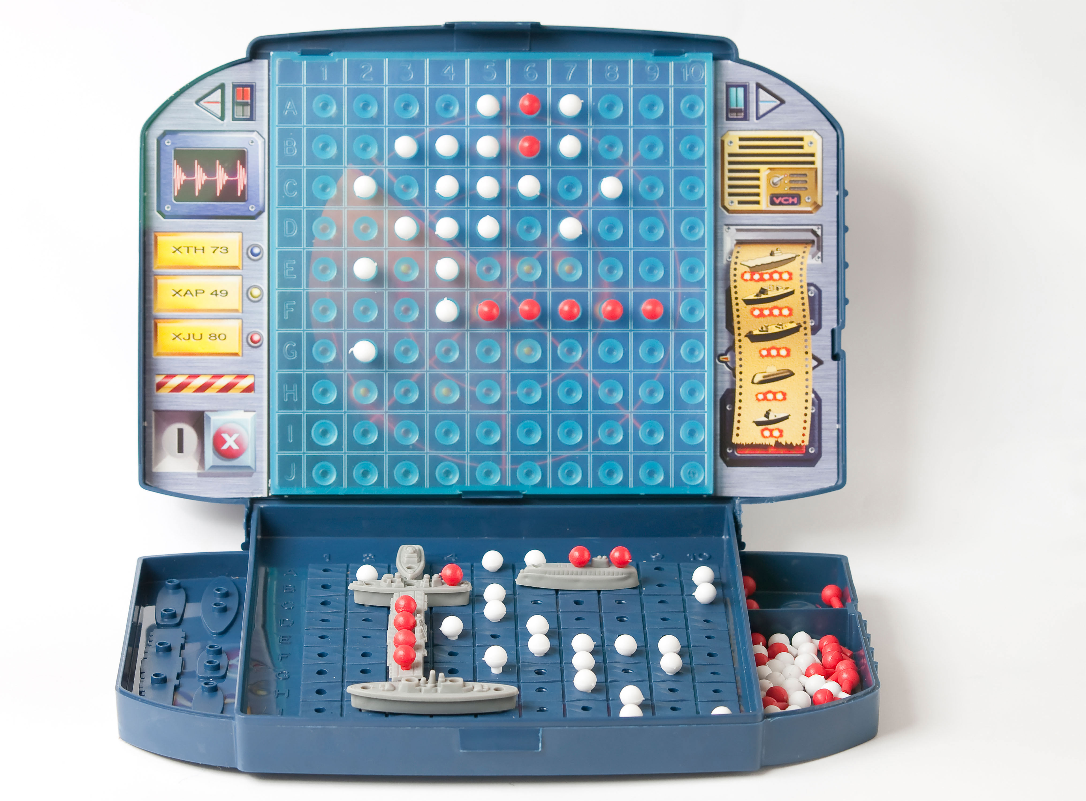
Just Like Battleship

Slide 7
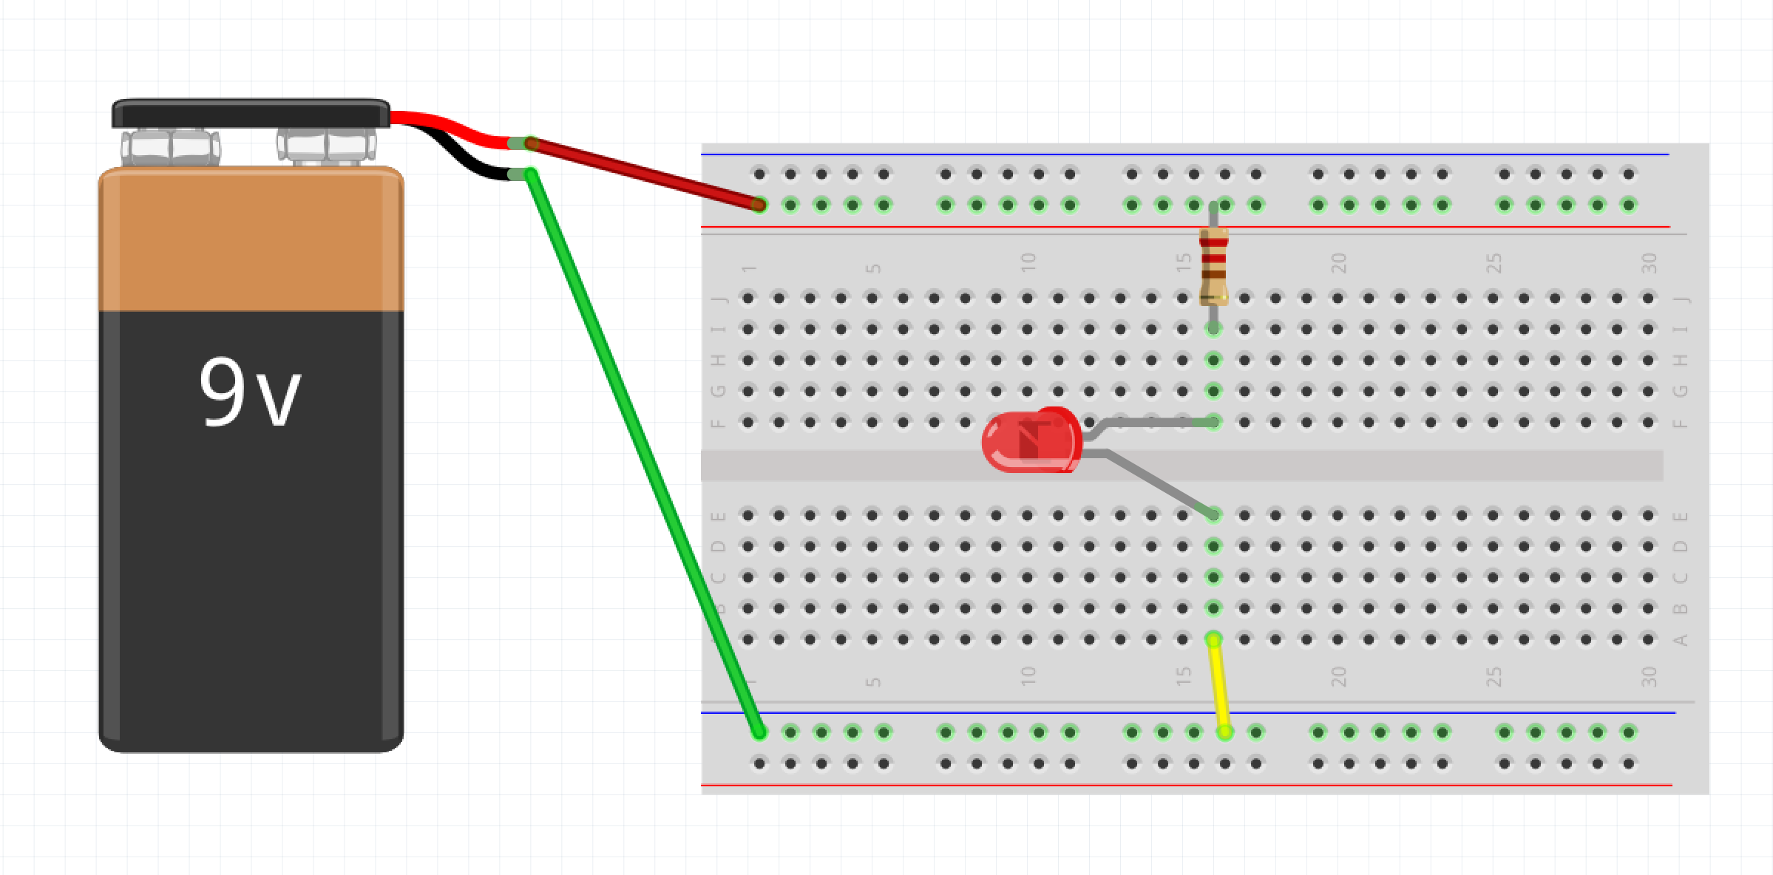
Wiring up a Circuit

Slide 8
Project 1 Parts List
Arduino
Breadboard
USB Cable
3 Male-Male wires
1 330 Ohm resistor
1 LED

Slide 9
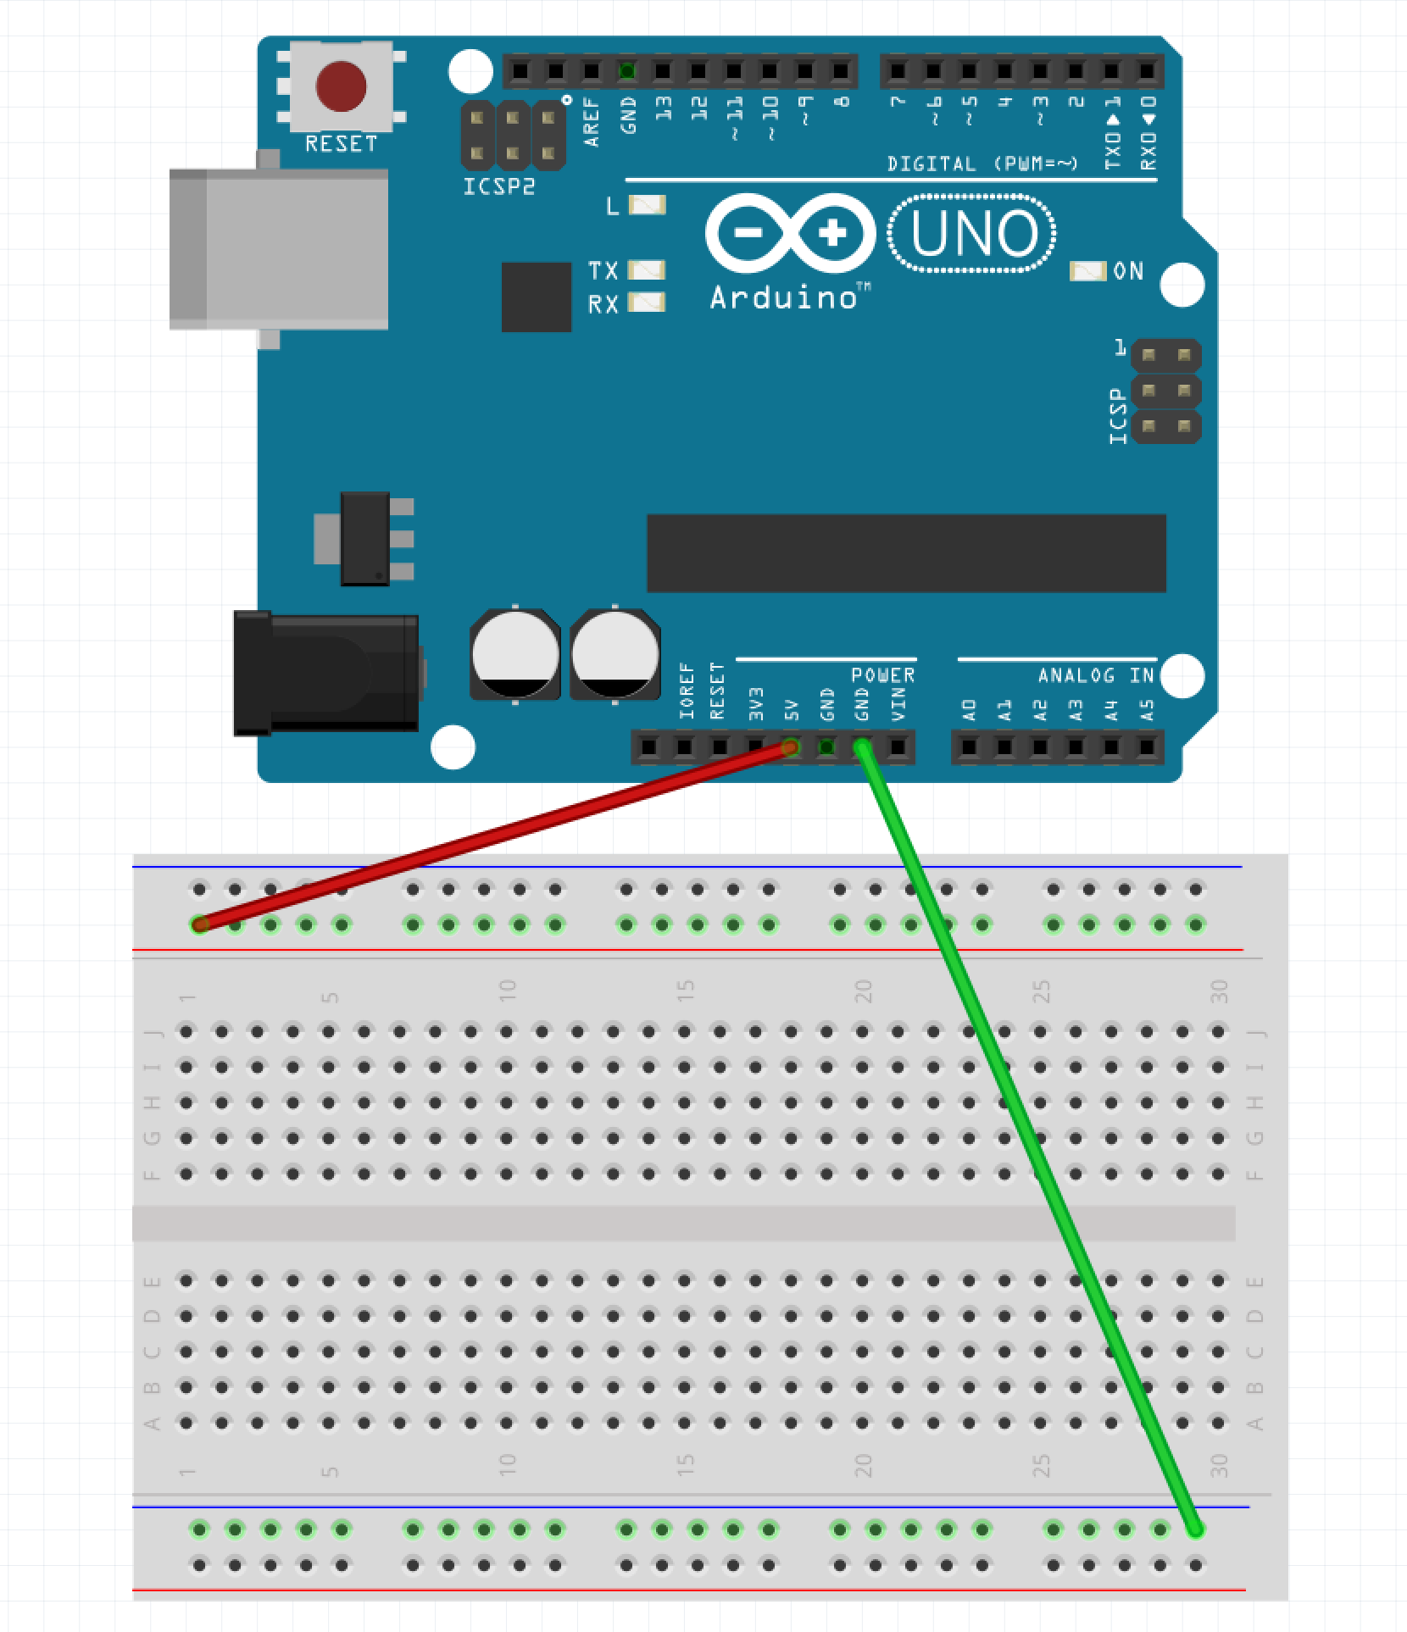
Step 1 – Wire up the Rails
Run wire from GND pin on Arduino to Blue Row on Breadboard (green wire in example)
Run wire from 5V pin on Arduino to Red Row on Breadboard (red wire in example)

Slide 10
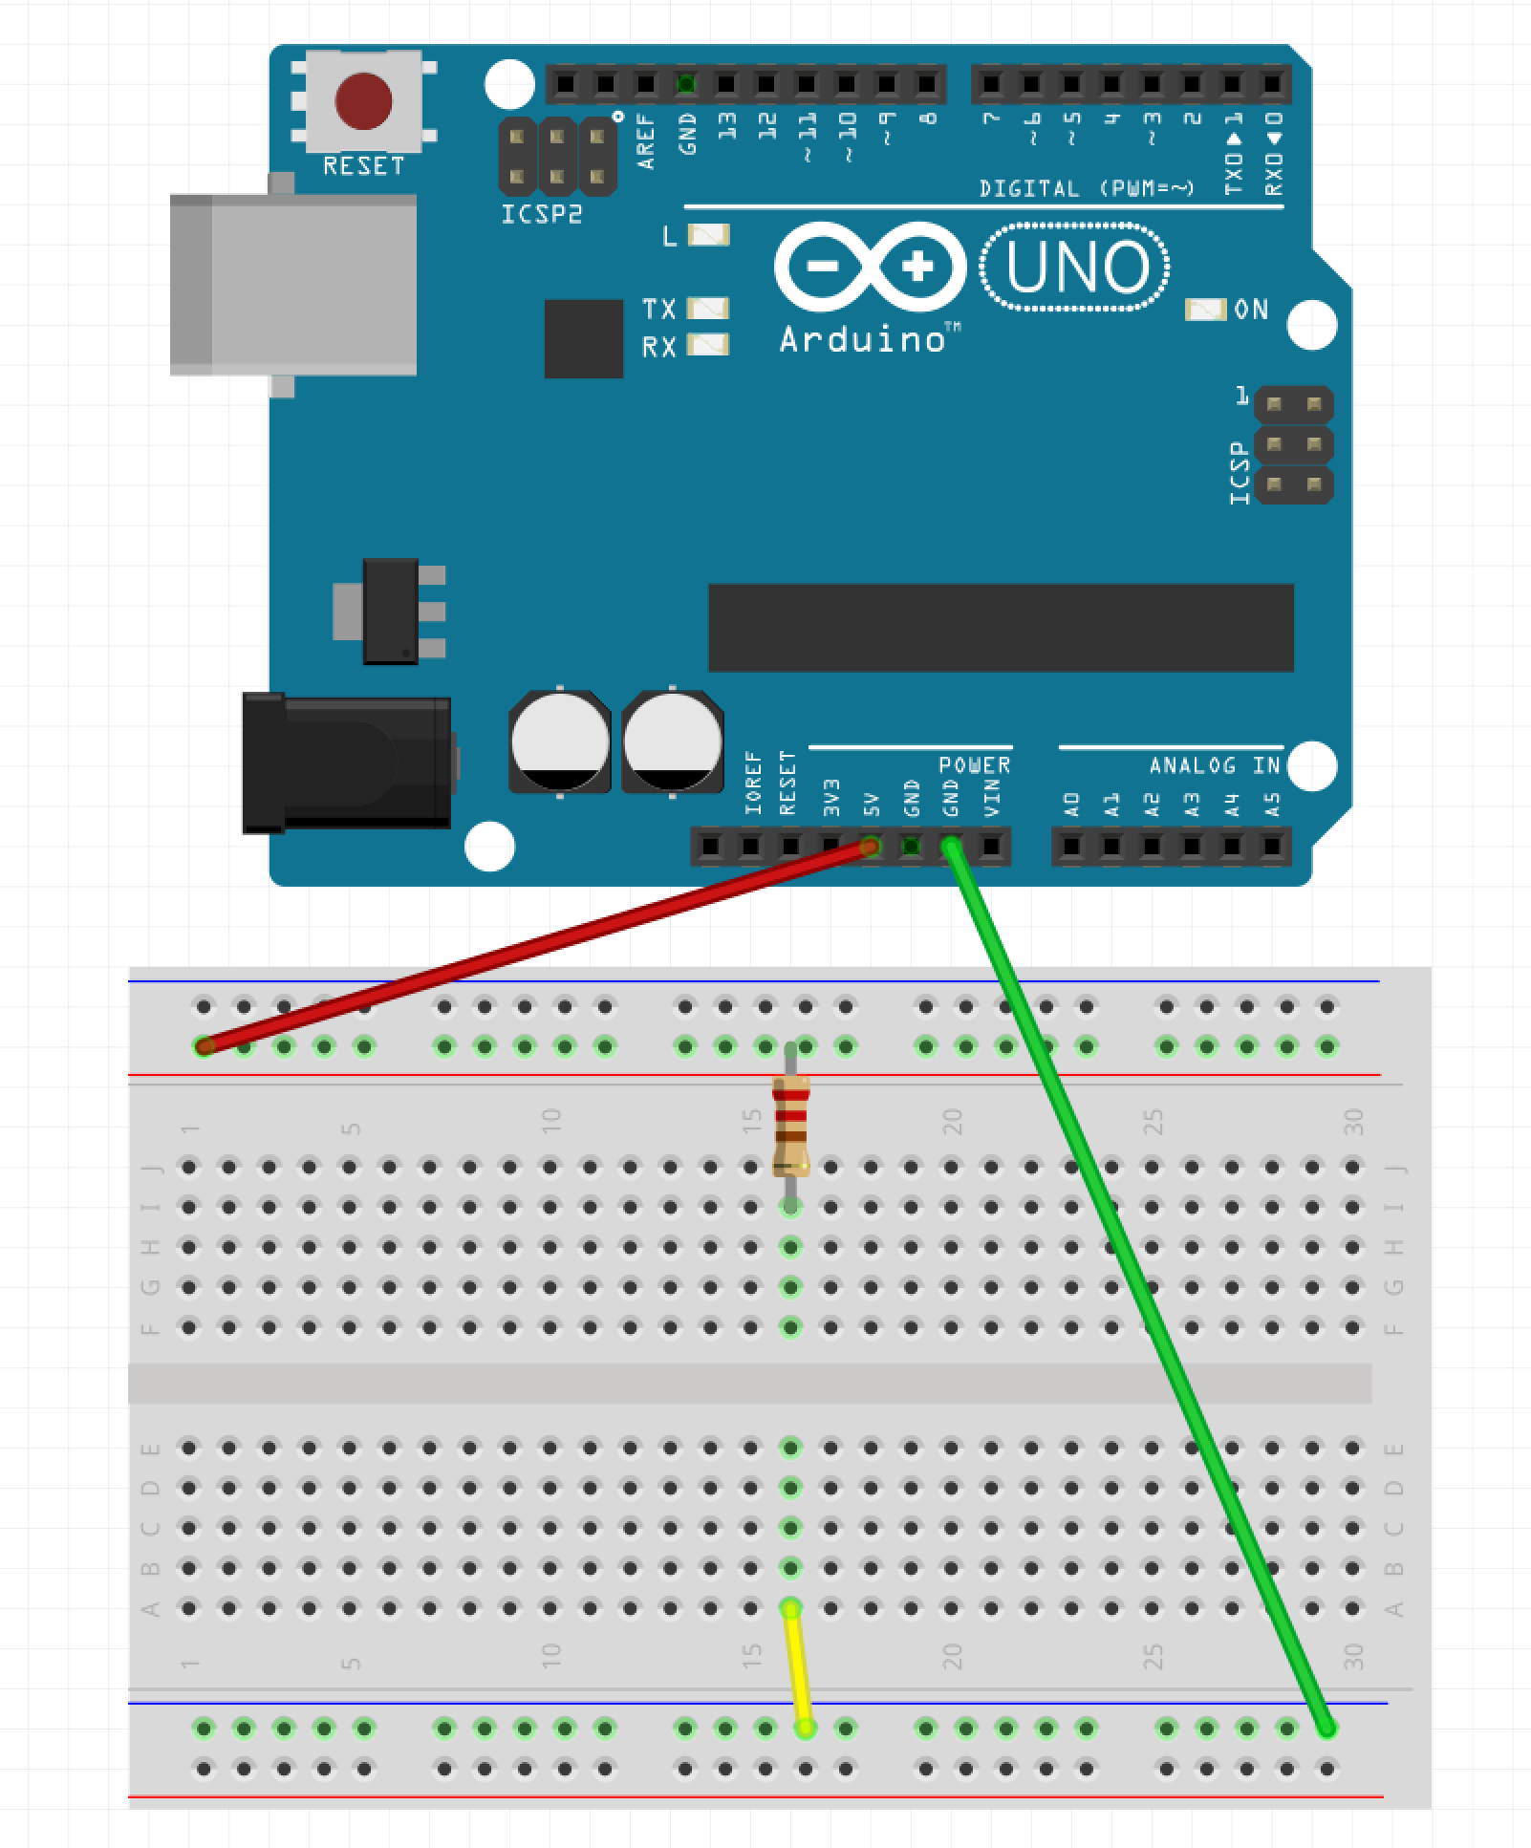
Step 2 – Place Resistor
Run wire from the blue row to A:16 (yellow wire in example)
Place one leg of resistor in the red row and the other in I:16

Slide 11
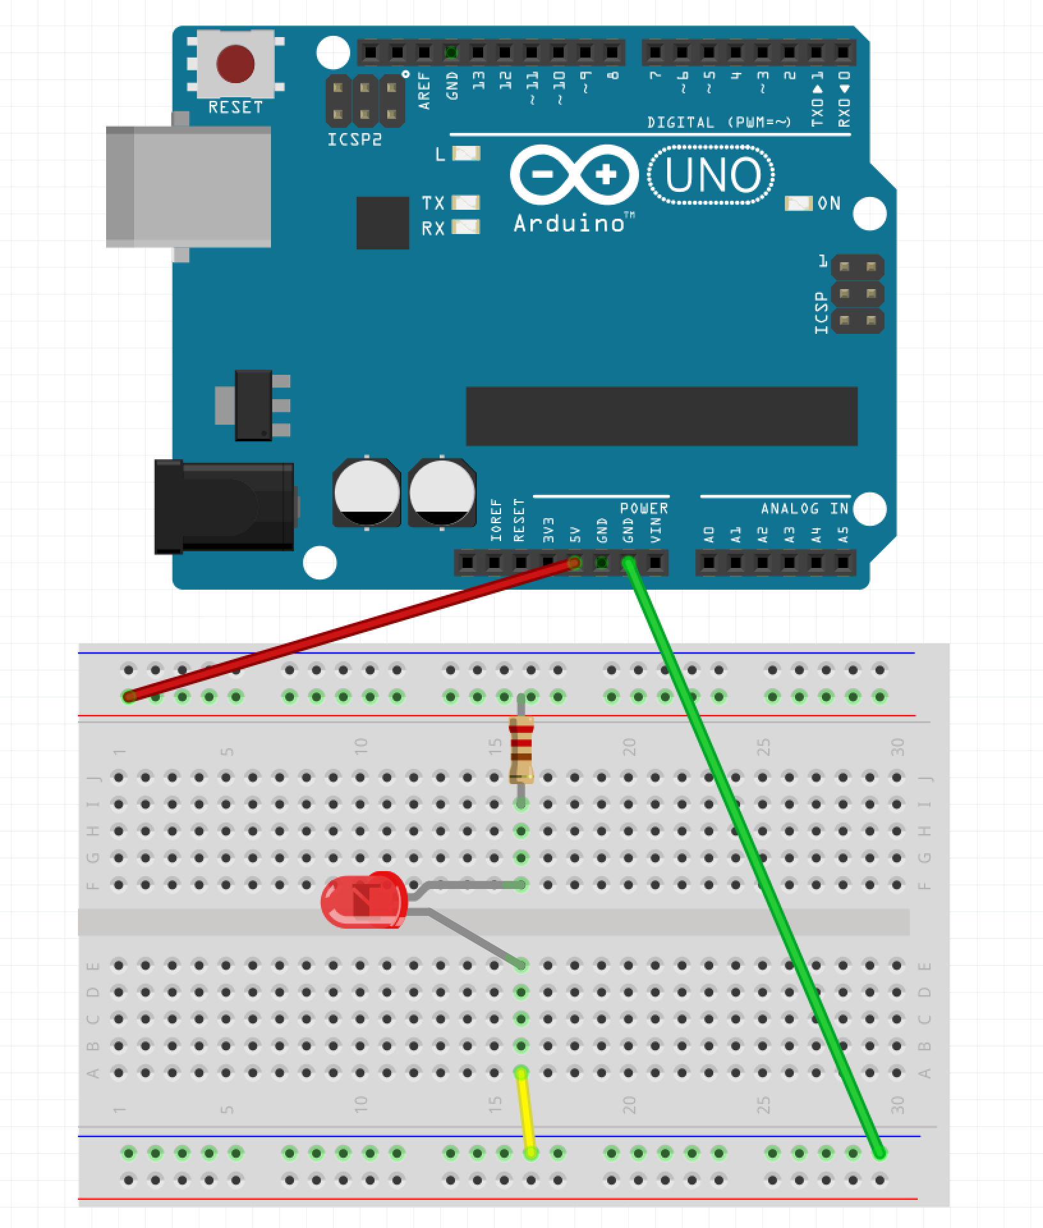
Step 3 – Place LED
Place the longer leg of the LED into F:16
Place the shorter leg of the LED into E:16

Slide 12
Step 4 – Apply Power
Plug the Arduino into the USB Cable
Plug the USB Cable into the PC

Slide 13
So What Just Happened?
Complete Circuit
Arduino acted like a battery
Resistor restricted current flow so LED isn’t damaged

Slide 14
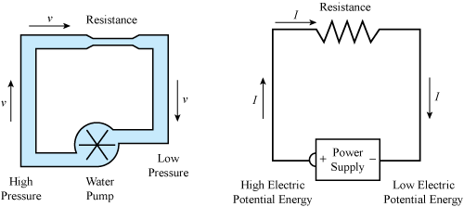
Water Analogy

Slide 15
LEDs

Slide 16
Why is one lead longer?

Slide 17
Project 2 Parts List
Arduino
Breadboard
USB Cable
3 Male-Male wires
1 330 Ohm resistor
1 LED
1 Button

Slide 18

Step 1 – Move the Wires
Make sure the USB Cable is not plugged into the PC
Move the wire plugged into GND on the Arudino from the blue row to J:25 on the breadboard (green wire in the example)
Move the wire plugged into 16:A from the blue row to A:25 (yellow wire in the example)

Slide 19
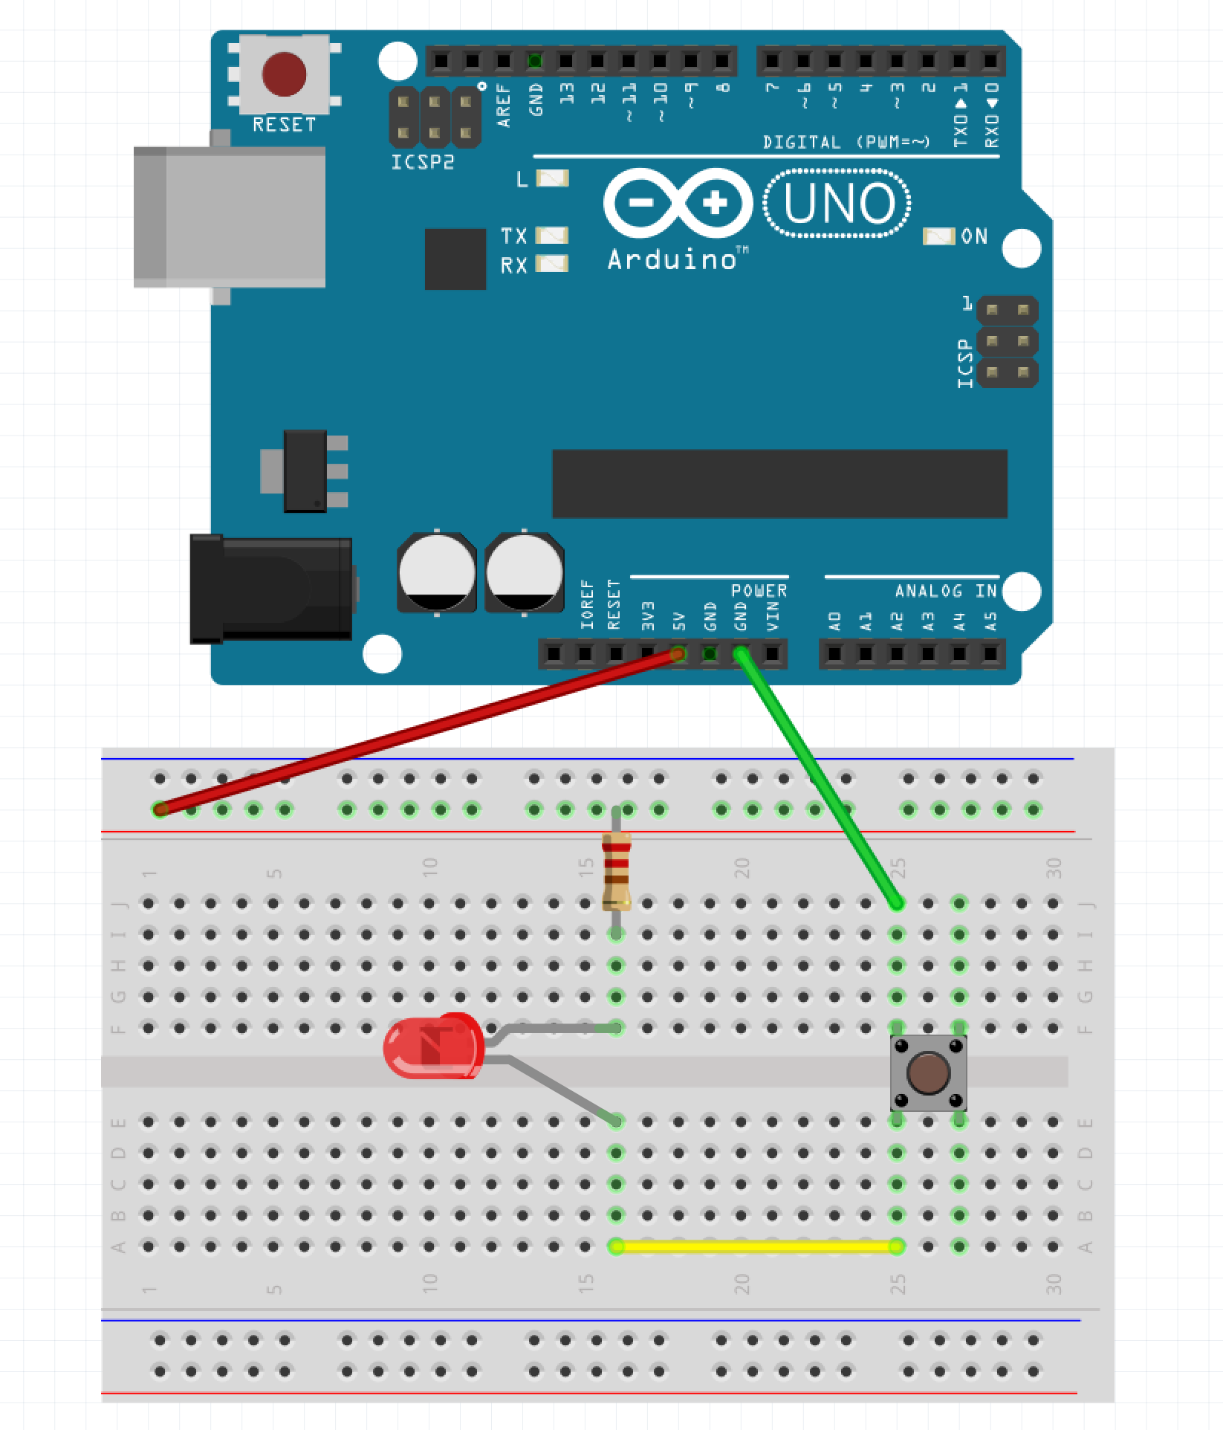
Step 2 – Place the Button
Place the button across the gap

Slide 20
Step 3 – Apply Power
Plug the Arduino into the USB Cable
Plug the USB Cable into the PC

Slide 21
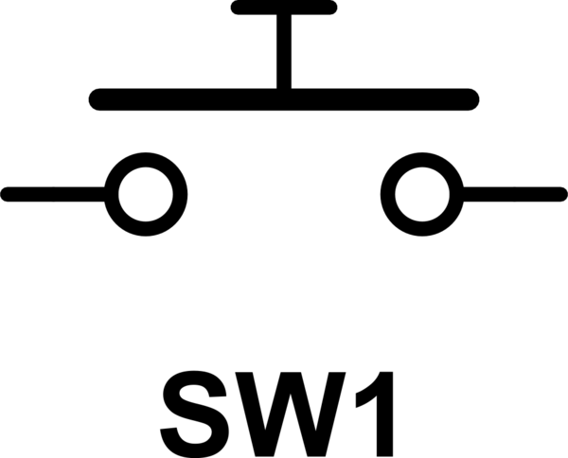
Button as a Switch

Slide 22
Project 3 - Let’s ’Read’ Something
The Arduino can ‘drive’ pins
The Arduino can also ‘read’ pins
Allows Arduino to ’read’ sensors, collect data, etc.

Slide 23
Project Parts List
Arduino
Breadboard
USB Cable
1 DHT11 Humidity / Temperature Sensor
3 Male-Female wires

Slide 24
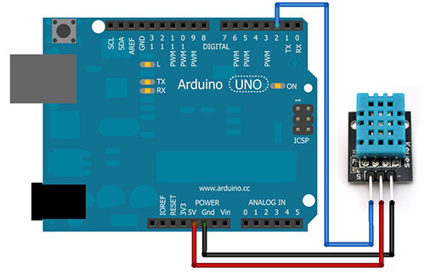
Step 1
Make sure the USB Cable is not plugged into the PC
Place a Male-Female connector running from the GND pin of the Arduino to the negative pin of the DHT11 (black wire in example)
Place a Male-Female connector running from the 5V pin of the Arduino to the middle pin of the DHT11 (red wire in example)
Place a Male-Female connector running from the 2 pin of the Arduino to the ‘S pin of the DHT11 (blue wire in example)

Slide 25
Step 2 – Power the Arduino
Plug the Arduino into the USB Cable
Plug the USB Cable into the PC

Slide 26
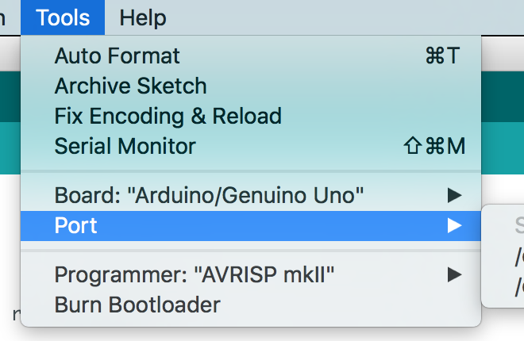
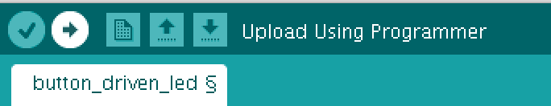
Step 3 – Program the Arduino
Open Sketch dht11.ino
Select Tools -> Port
Click the Upload Button

Slide 27
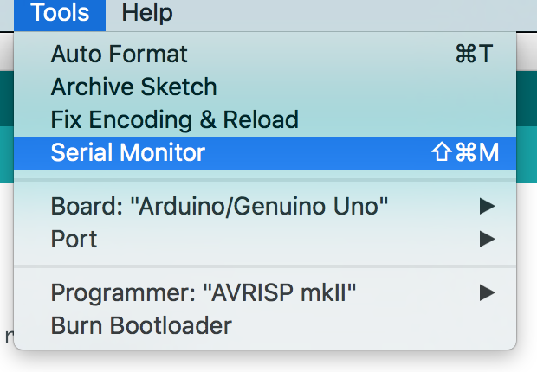
Step 4 – Open the Serial Monitor
Go to Tools and select ‘Serial Monitor’

Slide 28
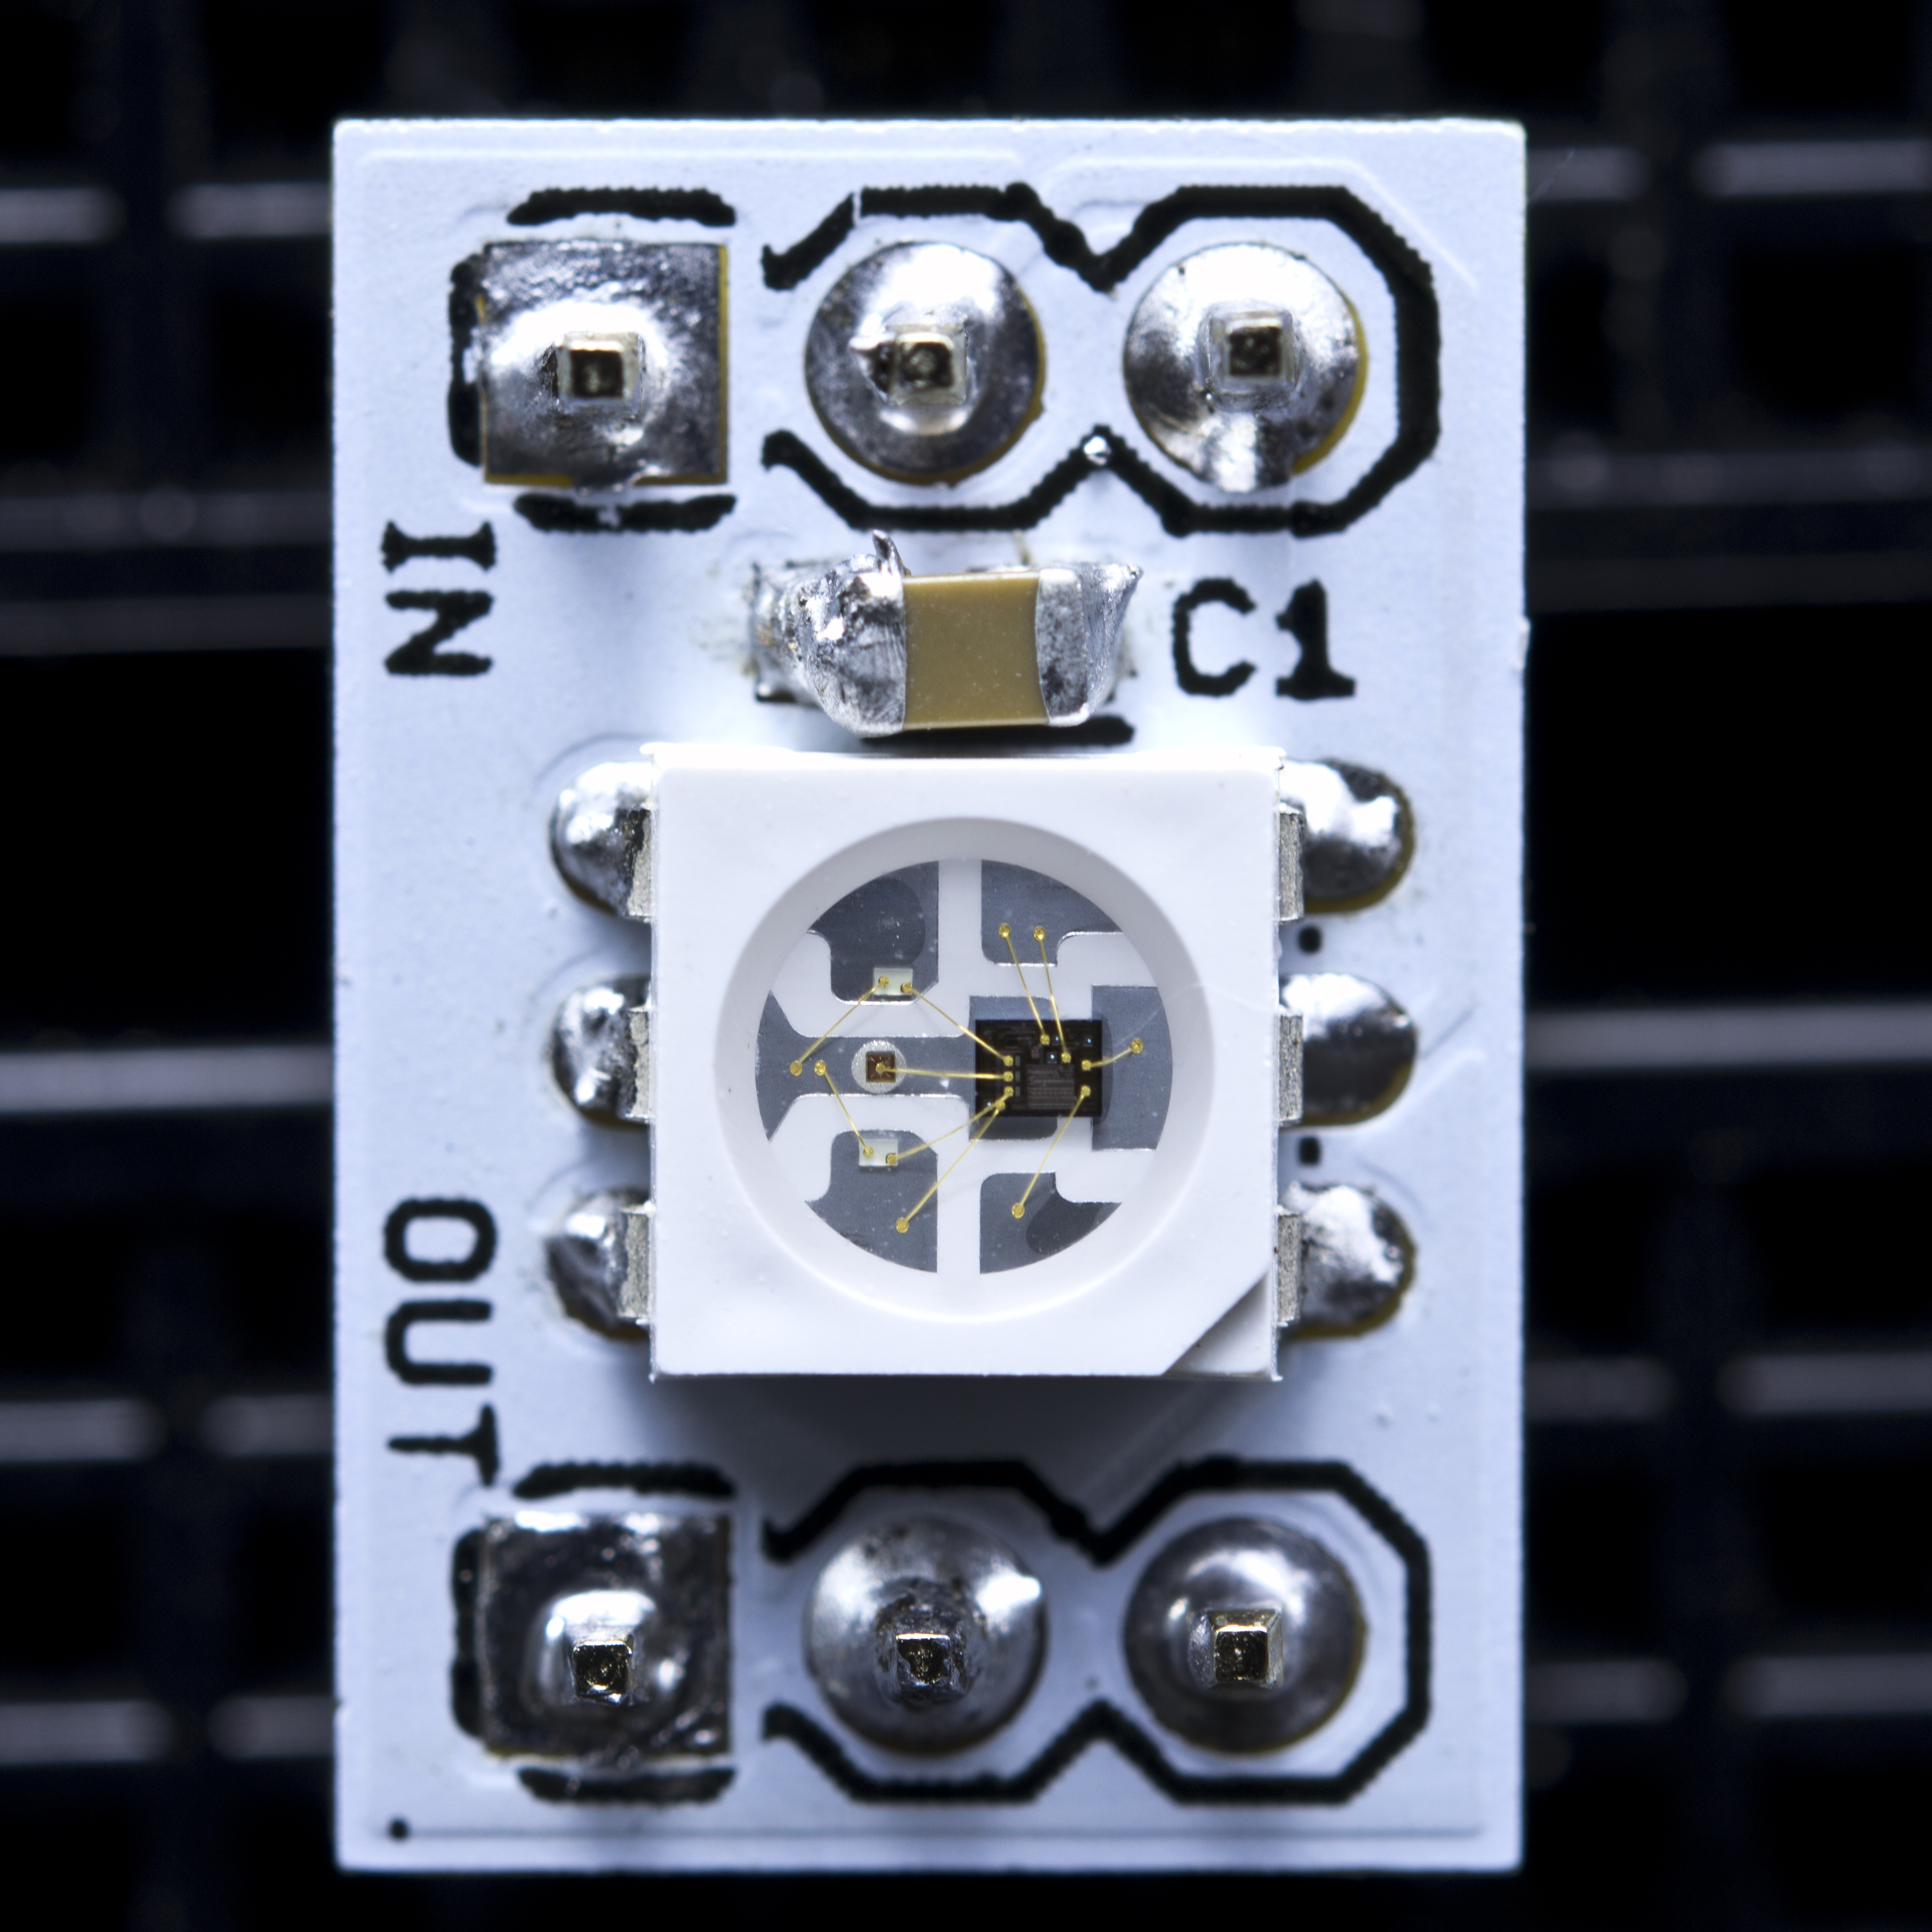
WS2811

Slide 29
Project 4 Parts List
Arduino
Breadboard
USB Cable
1 Neo Pixel Strip with 8 LEDs
1 1000F Capacitor (provided by Ryan)
1 10K Ohm resistor (in kit)
3 Male-Female wires (provided by Ryan)
3 Male-Male wires (in kit)

Slide 30
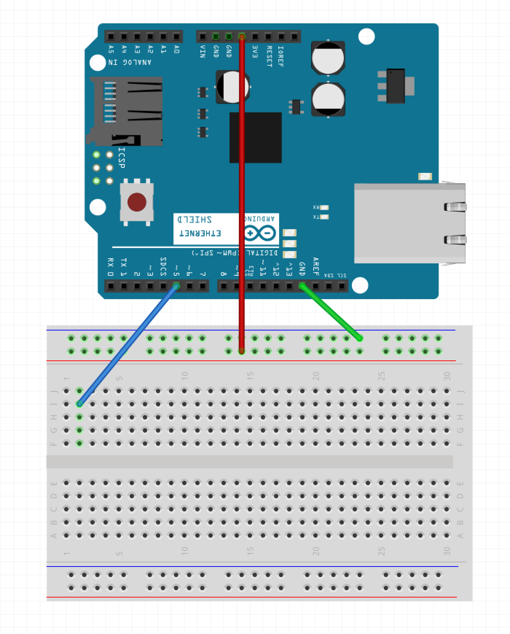
Step 1 – Wire the Rails
Run a wire from GND pin on Arduino to blue row on breadboard (green wire in example)
Run a wire from 5V pin on Arduino to red row on breadboard (red wire in example)
Run a wire from pin 5 of the Arduino to I:2 (blue wire in example)

Slide 31
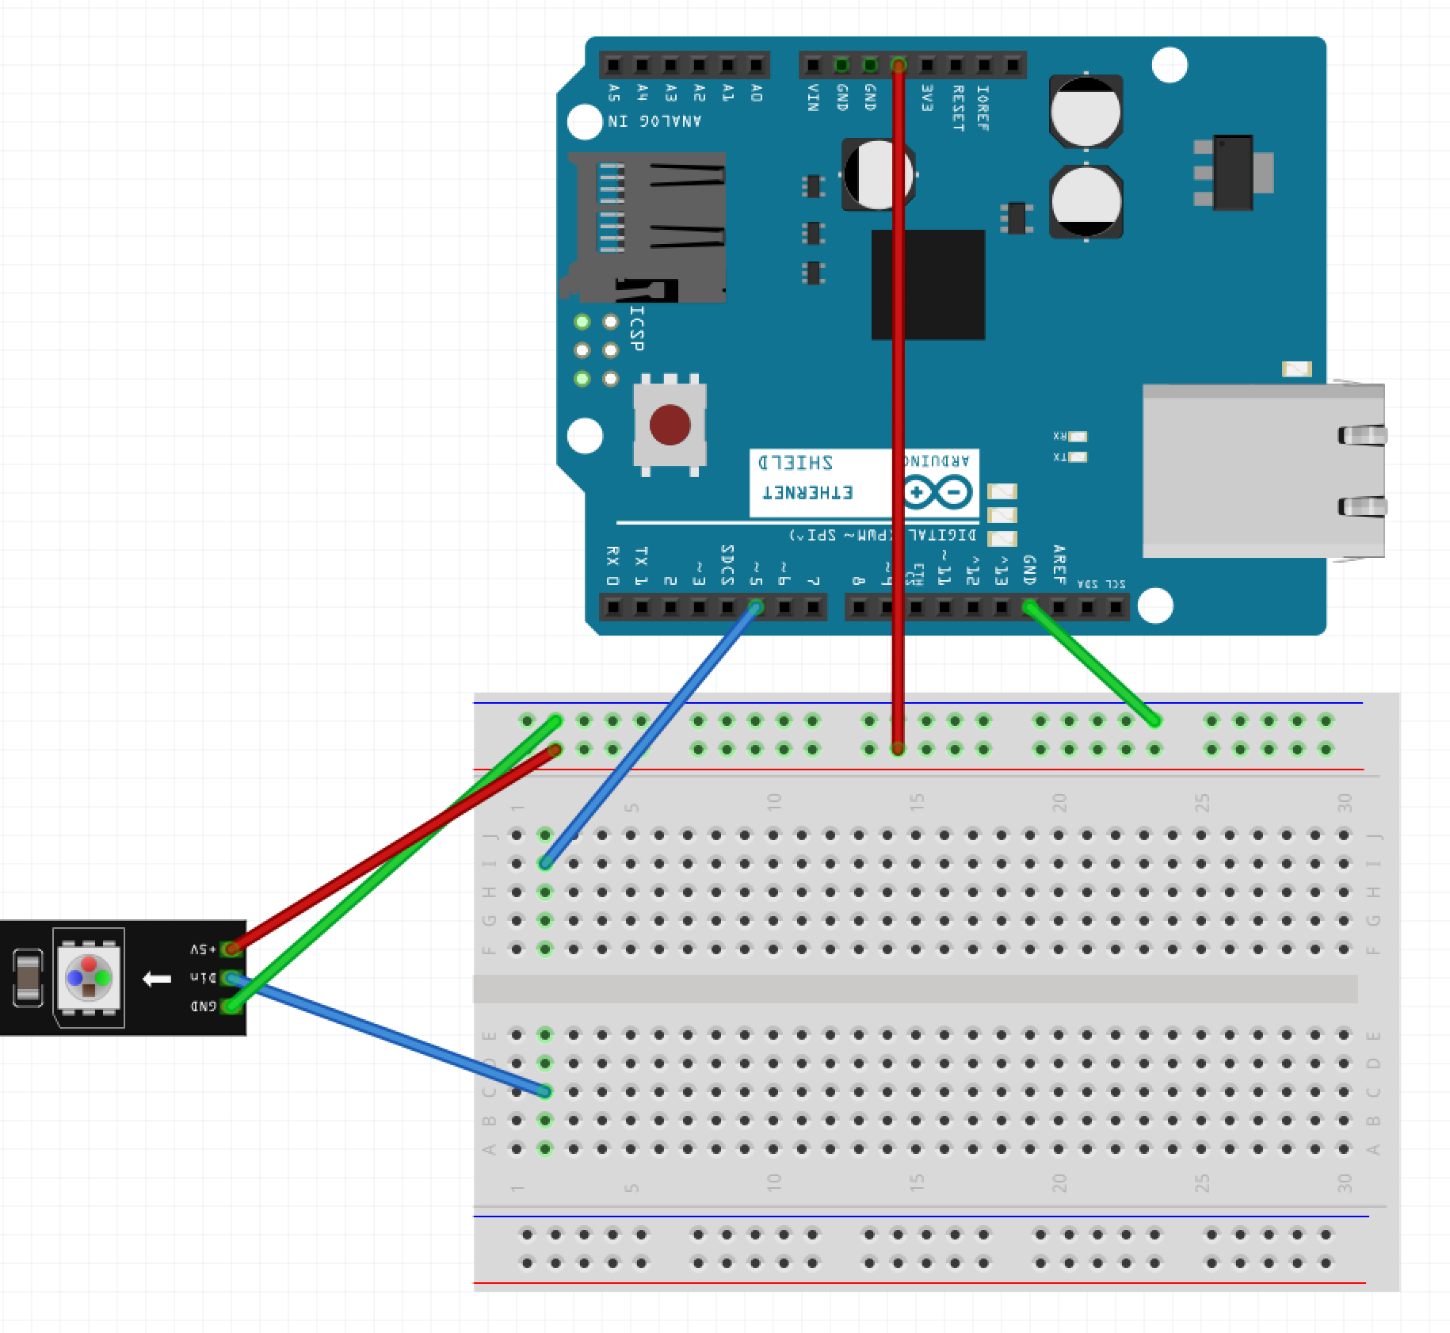
Step 2 – Wire the LED Strip
Run a wire from the Blue Row on breadboard to the GND pin of the LED strip (green wire in example)
Run a wire from the Red Row on breadboard to the 5V pin of the LED strip (red wire in example)
Run a wire from C:2 to the DIn pin of the LED strip (blue wire in example)

Slide 32
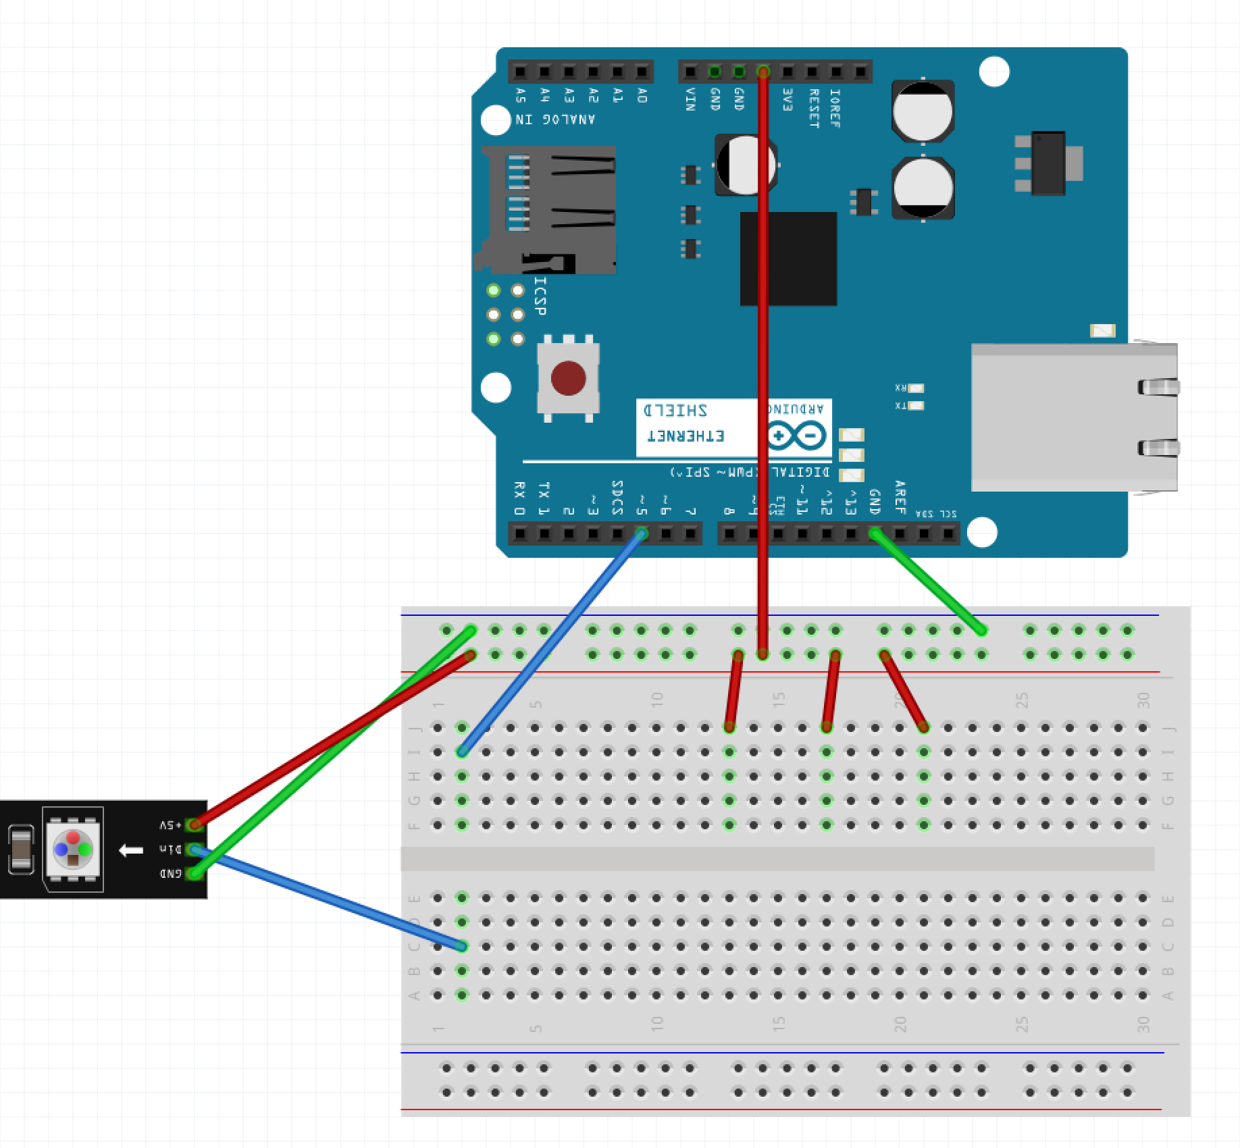
Step 3 – Wire One Side of Button
Run a wire from the Red Row on breadboard to J:13
Run a wire from the Red Row on breadboard to J:17
Run a wire from the Red Row on breadboard to J:21

Slide 33
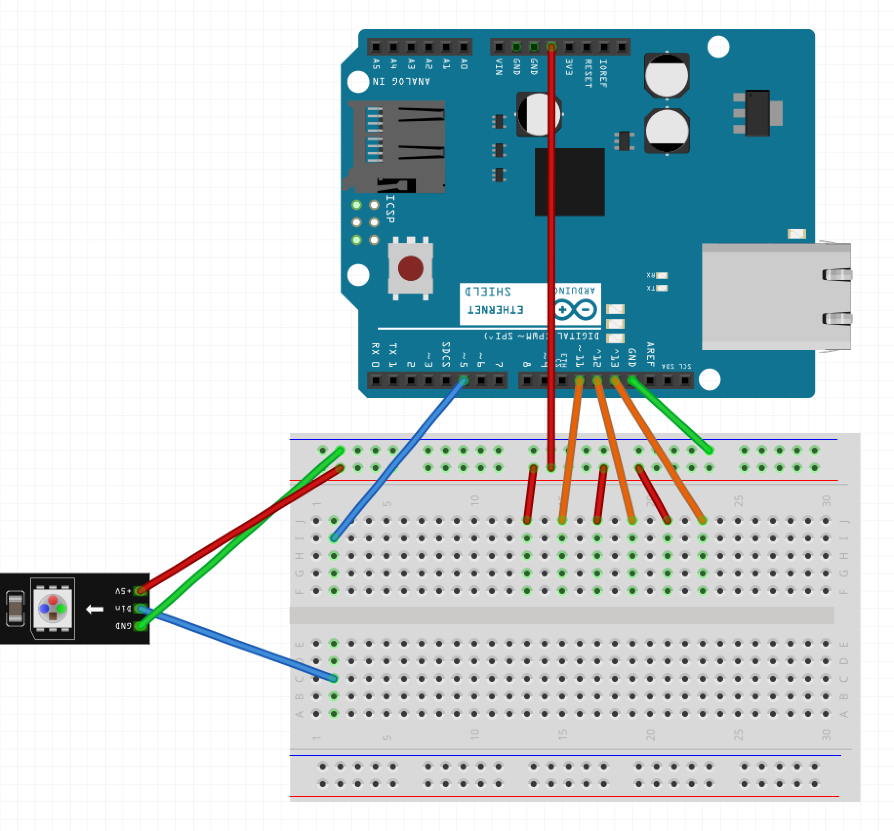
Step 4 – Wire Other Side of Button
Run a wire from pin 11 of the Arudino to J:15
Run a wire from pin 12 of the Arudino to J:19
Run a wire from pin 13 of the Arudino to J:23

Slide 34
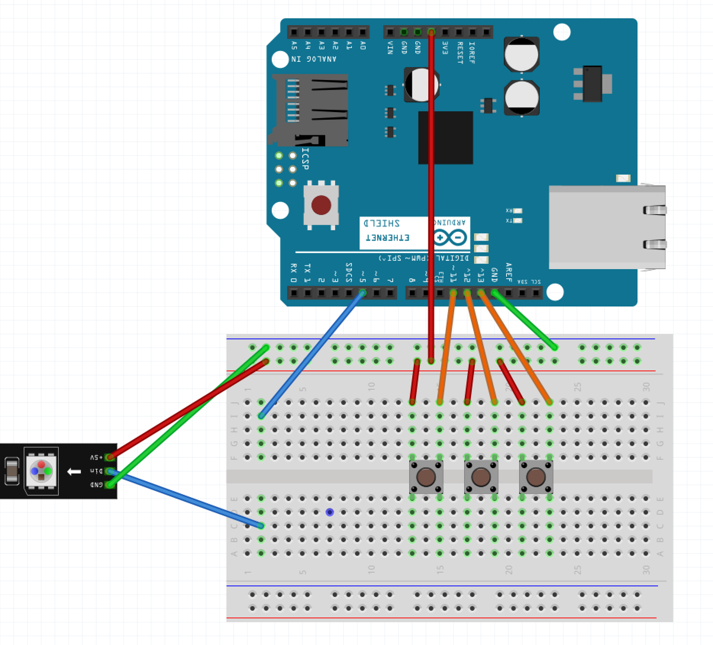
Step 5 – Button Placement
Place the 3 buttons
One in F:13 and F:15
One in F:17 and F:19
One in F:21 and F:23

Slide 35
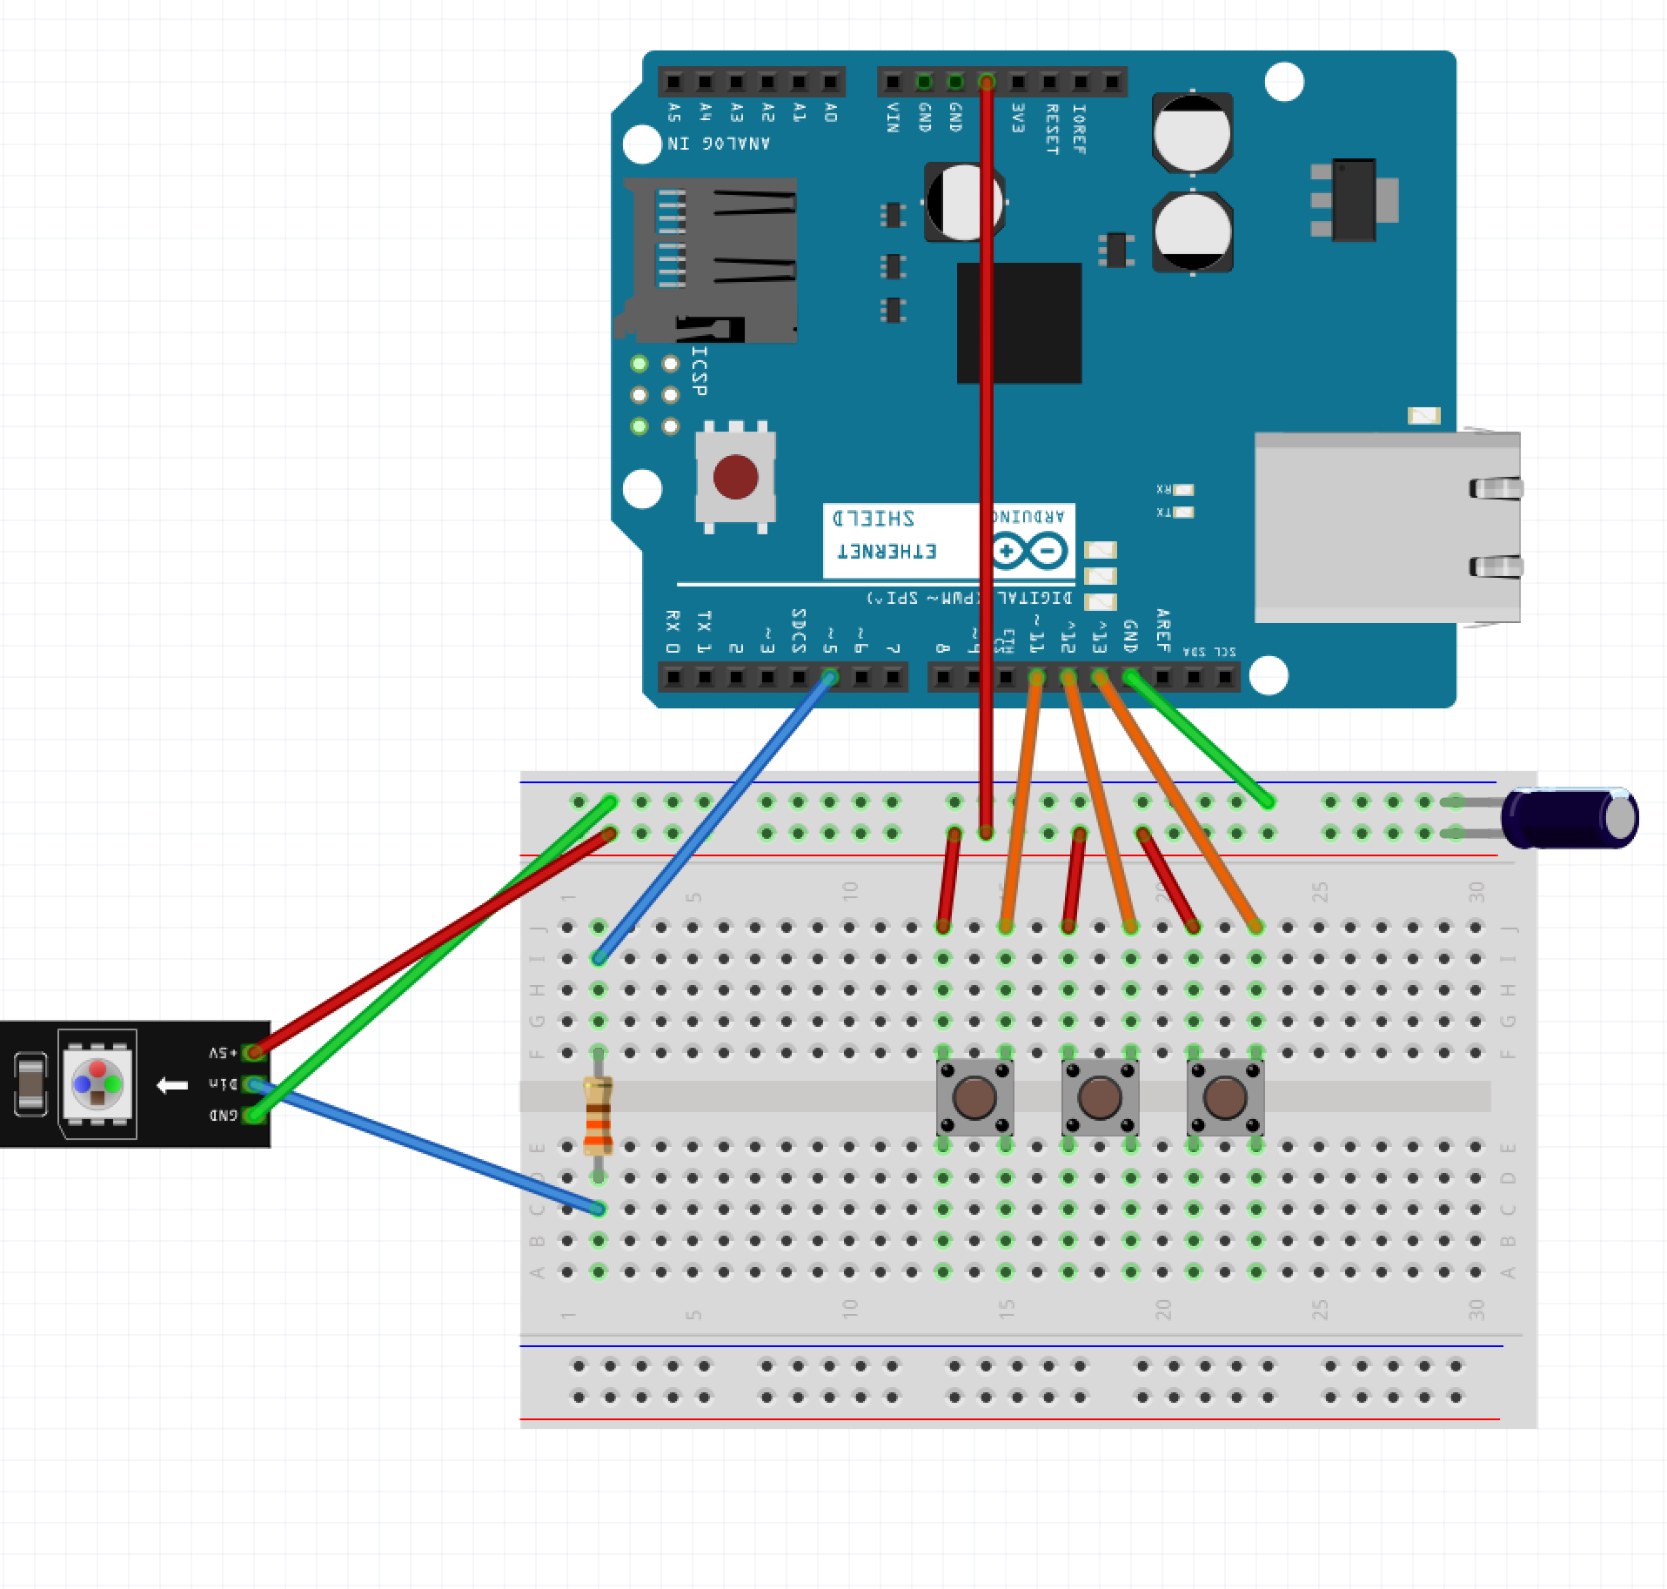
Step 6 – Components
Place the Resistor over the gap on F:2 and D:2
Place the capacitor with the long leg in the Red Row and the short leg in the Blue Row

Slide 36
Step 7 – Power the Arduino
Plug the Arduino into the USB Cable
Plug the USB Cable into the PC

Slide 37
Step 8 – Program the Arduino
Open Sketch button_driven_led.ino
Select Tools -> Port
Click the Upload Button

Slide 38
Putting it All Together
https://youtu.be/ahpPqD7Ju5w?t=17s

